Slide 1
Predicting conflict clusters in Africa
A spatiotemporal ACLED pipeline idea
Group 5
SICSS June 2026
1

Slide 2
Agenda
1. Conflict clustering as a spatial question
2. What ACLED data contains
3. Turning events into a grid-cell monthly panel
4. Hypotheses: local persistence and spatial diffusion
5. Modeling and validation strategy
6. Reproducible pipeline and next steps
2

Slide 3
Core idea: conflict risk moves through space and time
Instead of predicting "conflict in Africa" as one continent-wide number, the project treats conflict as a local and time-varying process.
Africa is divided into geographic grid cells, observed month by month.
Question is, whether recent conflict in and around a cell helps predict conflict in that cell in the next month?
3

Slide 4
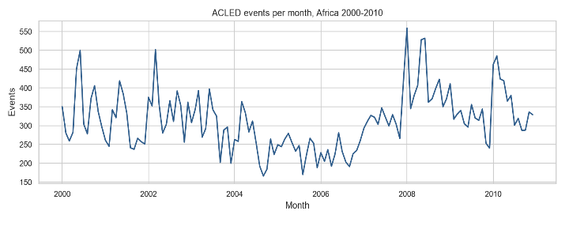
ACLED data planned to be used
Source: ACLED event data
Period: Jan 2000 to Dec 2010
Spatial scope: African countries in the file
Events: 41,299 reported events
Countries: 48
Core fields: date, coordinates, event type, actors, fatalities
Use: input data for grid-cell monthly prediction
4

Slide 5
What one ACLED row tells us
- Each row is a reported conflict event.
- The row includes a date, latitude and longitude, country and administrative location, event and sub-event type, involved actors, fatalities, and source notes.
- The raw row is not yet the unit of prediction. It is an observation that can be aggregated into a consistent space-time panel.
- This matters because the model needs comparable units: the same places, observed repeatedly through time, including months with no reported conflict.
5

Slide 6
Research question and hypotheses
Research question: How conflict clusters spread over time and space?
H1 Spatial diffusion: conflict in nearby cells raises risk in the focal cell, even after accounting for the focal cell's own history.
H2 Scale robustness: the same broad pattern should be visible when the grid is made smaller (50 x 50km) or larger (200 x 200km).
6

Slide 7
The ACLED Pipeline
1. Start with point events: latitude, longitude, date, and event attributes.
2. Assign each event to an approximate 100 x 100 km grid cell.
3. Count events and fatalities by cell and month.
4. Add explicit rows for cell-months with zero reported events.
5. Shift the outcome forward: use earlier information to predict conflict next month.
7

Slide 8
The 100 km grid-cell monthly 2000-2010 panel
Grid: 100 x 100 km cells
Rows: 187,592 cell-months
Cells: 1,432 geographic cells
Months: 131 (10x12+11=131 : Jan 2000 - dec 2010)
Outcome: any conflict in the next month
Purpose: a structured map-time table for prediction
8

Slide 9
What the model is allowed to know
Only information available before the prediction month is used.
Local history: whether the same cell had conflict in the last 1, 3, 6, or 12 months.
Intensity history: recent event counts and fatality counts, summarized over rolling windows.
Neighbor history: recent conflict in nearby grid cells, used to test spatial diffusion.
Context controls: month and country patterns, plus event-type histories where useful.
9

Slide 10
Modeling strategy
The models compare increasingly informative explanations of next-month conflict risk.
Baseline: broad place and time patterns.
Local-history model: adds what happened in the same cell recently.
Neighbor model: adds what happened around the cell recently.
Extended model: adds richer event-type and intensity information.
Logistic regression keeps the design interpretable; random forests test whether flexible patterns add predictive value.
10

Slide 11
Planned validation strategy
Time should be split chronologically, because the real task is forecasting future months.
build and explain the model using the 2000-2010 ACLED data. Add 2011-2020 as a later out-of-sample test period.
The main grid is 100 km x 100 km, with 50 km and 200 km robustness checks.
Evaluation should ask whether high-risk cells are useful and calibrated, not only whether a single threshold looks good.
11

